Slide 1
Image Processing with Fourier Transform

Slide 2
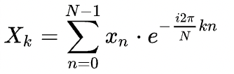
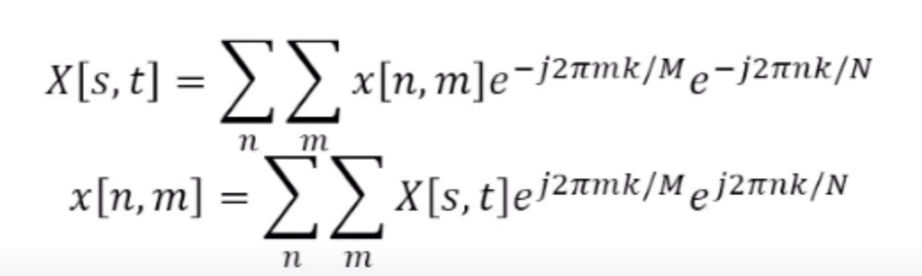
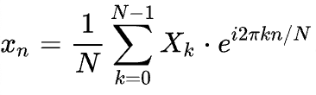
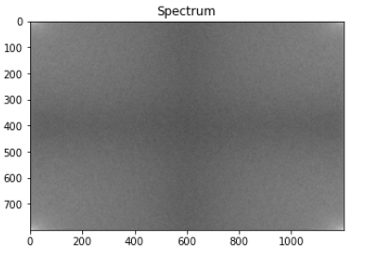

Finite and Discrete Input and Output
The Discrete Fourier Transform transforms a sequence of N complex numbers
{x_{n}} = x0, x1,…..x_{n-1} into another sequence of complex numbers
{X_{k}} = X₀, X₁,….X_{N-1}, which is defined by
One dimension
Two dimension
We’re using FFT – Fast Fourier Transform (FFTs are faster ways of doing DFTs)
original = np.fft.fft2(img)
plt.subplot(152), plt.imshow(np.log(1+np.abs(original)),'gray'), plt.title("Spectrum")

Slide 3

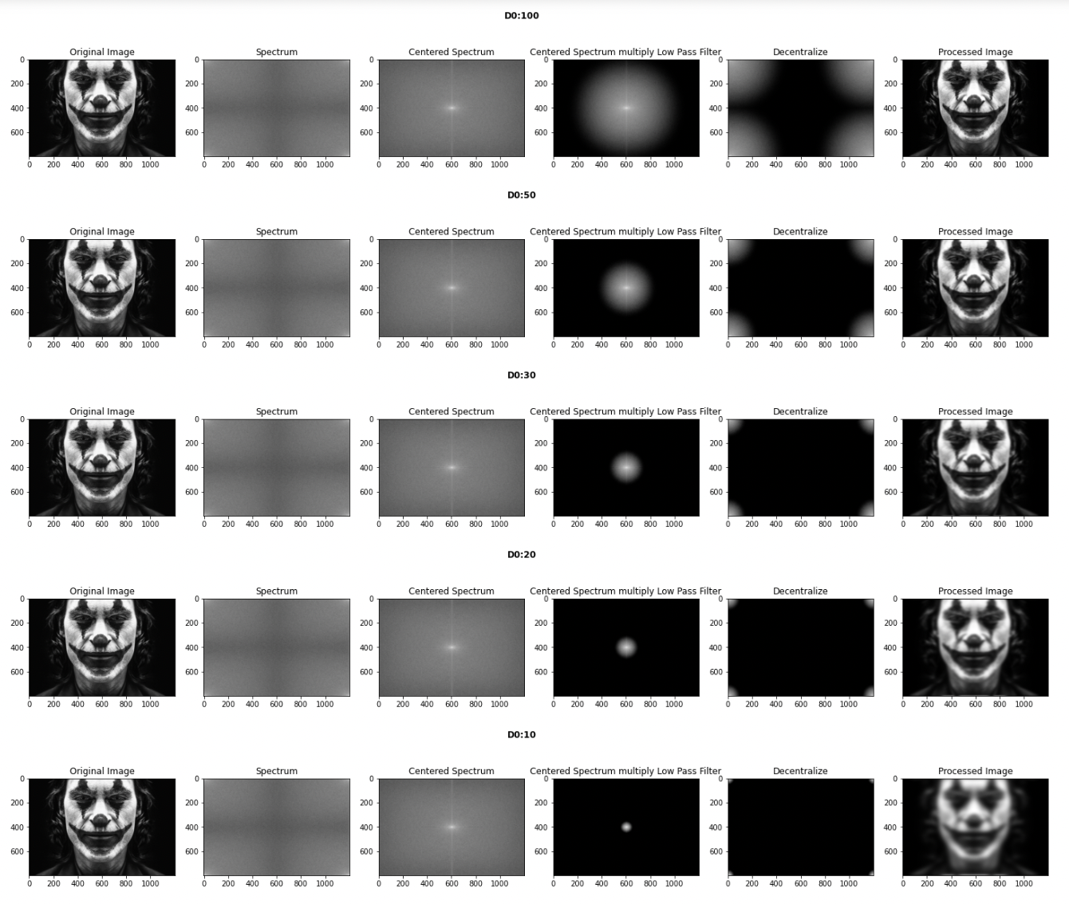
Blurring using Low Pass Filter
Low Pass Filter only allow low frequencies to pass

Slide 4

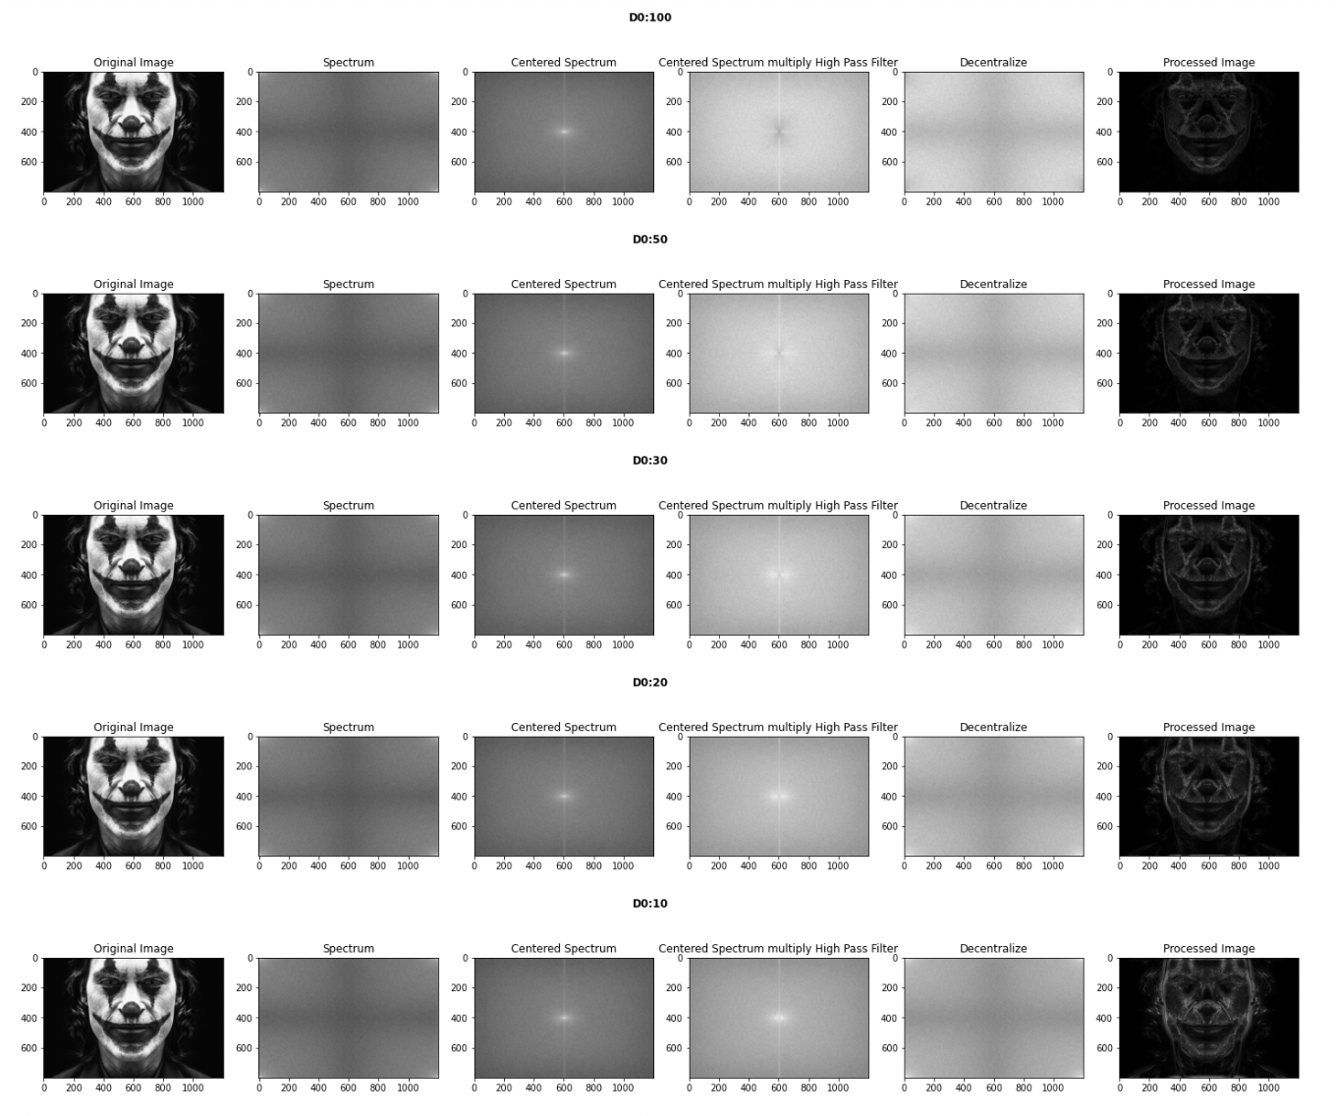
Edge Detection using High Pass Filter
High Pass Filter, on the contrary, only allow higher frequencies to pass

Slide 5
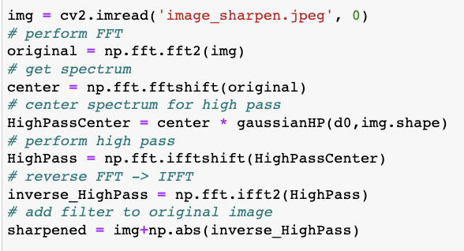
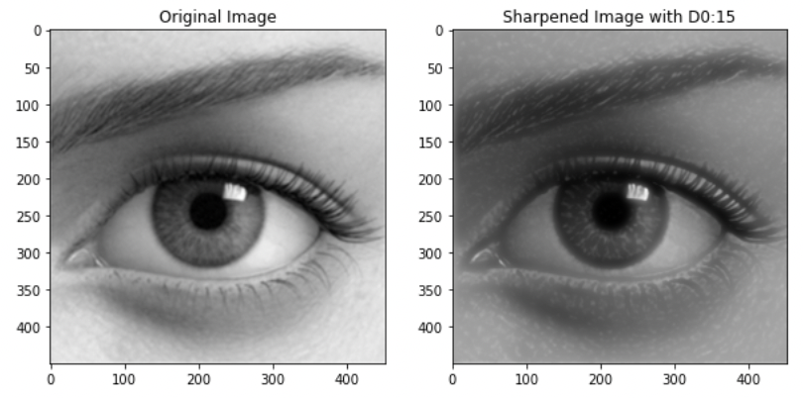
Image Sharpening using High Pass Filter
Image sharpening is done by adding to the original image a signal proportional to a high-pass filtered version of the image.

Slide 6
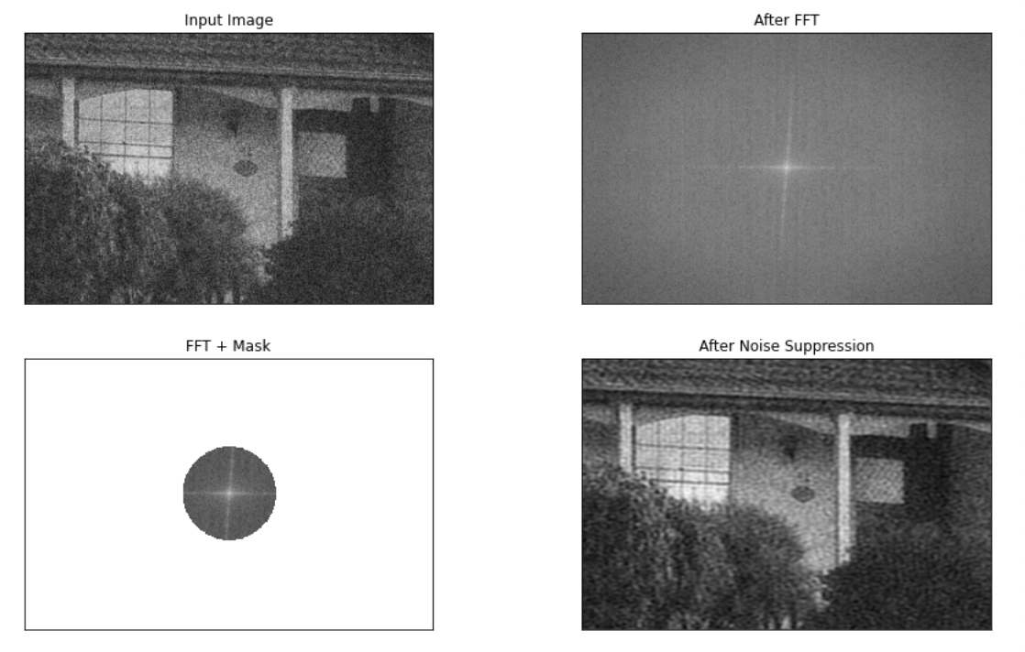
Noise Suppression using Low Pass Filter
A low pass filter (LPF) is used to remove high frequency noise from the signal and preserves the low frequency components in the signal

